Slide 1
WELCOME

Slide 3
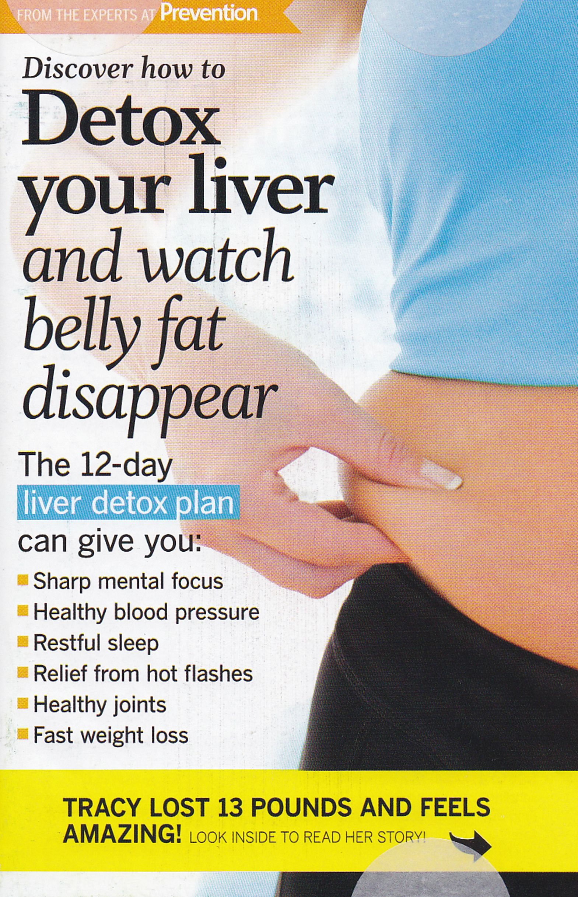

Slide 4
A process or period of time in which one abstains from or rids the body of toxic or unhealthy substances.
DETOX

Slide 5
Six Ways to Detox
Choose the Right Foods
Exercise and Meditation
Diet
Purify the Air You Breathe
Purify Your Body With Water
6. A Complete Body Detox
Global Healing Center

Slide 6
INTENT of DETOX
New patterns of wellness
Improve overall health
Different habits of behavior

Slide 7
Ridding the soul—
our mind, will, and emotions—
of those things that
negatively affect
our spiritual well-being and health
as believers in Christ.

Slide 8
BEHAVIORS, EMOTIONS, & INFLUENCES
Keep us stuck in immature patterns of behavior
Highjack our lives resulting in “bondage and baggage”
Negatively IMPACT OUR LIFE PURPOSE
Finger pointing
Quick fixes

Slide 9
“So run, that ye may obtain.” I Corinthians 9:24

Slide 10
“unhealthy behaviors,
lethal emotions,
and
toxic influences”
Notes:
Because of these two factors, we see them manifested in
Unhealthy behaviors
Lethal emotions and
Toxic influences

Slide 11
Foundational to Detox Success
OUR REALITY
OUR IDENTITY

Slide 12
Our Reality
“We believe in God who is the ABSOLUTE SOURCE of life from which (WHOM) ALL CREATION derives ITS MEANING and REALITY”

Slide 13
Our Identity is in Christ
Therefore, if anyone is in Christ, he is a new creation; old things have passed away; behold, all things have become new.

Slide 14
For whom He foreknew, He also predestined to be
conformed
to the
image of His Son,
that He might be the firstborn
among many brethren.
Romans 8:29

Slide 15
Three Toxic Areas
Behaviors
Emotions
Influences
BE In

Slide 16
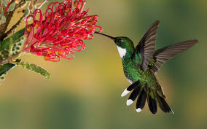
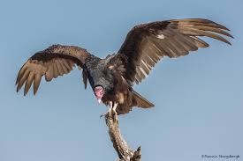
TOXIC BEHAVIOR
You will be filled
with what
you feed on your mind!
TOXIC BEHAVIOR BEGINS
WITH
TOXIC THOUGHTS AND
PATTERNS OF SIN

Slide 17
Toxic Thoughts
BITTERNESS
ANXIETY
ffear
fear
discontent
cicritical
negative
PESSIMISM
CRITICISM

Slide 18
Patterns of Sin
“Sow a Thought, Reap an Action;
Sow an action, Reap Habit;
Sow a Habit, Reap a Character;
Sow a Character, Reap a Destiny.”
IT’S THE SAME WITH
PATTERNS OF SIN THAT REMAIN
OUR LIVES

Slide 19
Colossians 3:5-9
So put to death the sinful, earthly things lurking within you. Have nothing to do with sexual sin, impurity, lust, and shameful desires. Don't be greedy for the good things of this life, for that is idolatry…now is the time to get rid of anger, rage, malicious behavior, slander, and dirty language. 9 Don't lie to each other, for you have stripped off your old evil nature and all its wicked deeds.

Slide 21
“Let all bitterness, wrath, anger, clamor, and evil speaking be put away from you, with all malice.
And be kind to one another, tenderhearted,
forgiving one another, just as God in Christ forgave you.”
Ephesians 4:30-32

Slide 22
E·mo·tions (əˈmōSH(ə)ns)
a natural response to
our circumstances, mood
or
relationships with others

Slide 23
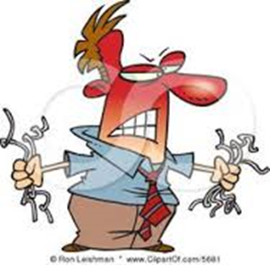
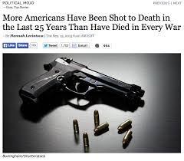
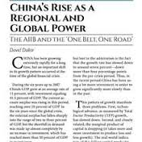
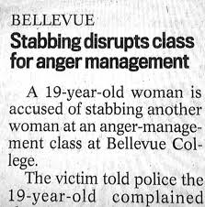

Slide 24
TOXIC EMOTIONS
FEAR
ANGER
MALICE
ENVY

Slide 25
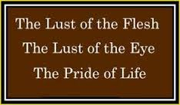
TOXIC INFLUENCES
“Anything that draws us from God”
1 John 2:15-17

Slide 26
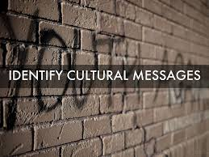
Culture Messaging

Slide 27
Culture Messaging
ON THE TOPIC OF… | THE DOMINANT MESSAGE OF OUR CULTURE IS…
MONEY | “Get all you can and spend all you can.”
MARRIAGE
HAPPINESS
SEX
SUCCESS
APPEARANCE/BEAUTY
WORK

Slide 28
THE APOSTLE PETER’S ANSWER How to Sustain a Healthy Soul? Gird up the loins of your mind, be sober, and hope to the end for the grace that is to be brought unto you at the revelation of Jesus Christ; {to the end: Gr. perfectly} 1 Peter 1:13
“Prepare your minds for action;
be self-controlled;
set you hope fully on the grace to be given you when Jesus Christ is revealed.”

Slide 29
A I M
Awareness
Intentionality
Maturity

Slide 30
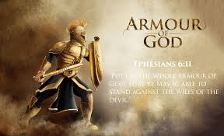
AWARENESS

Slide 31
INTENTIONALLY

Slide 32
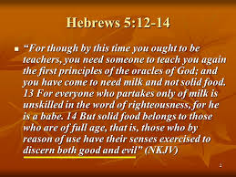
MATURITY

